Slide 1
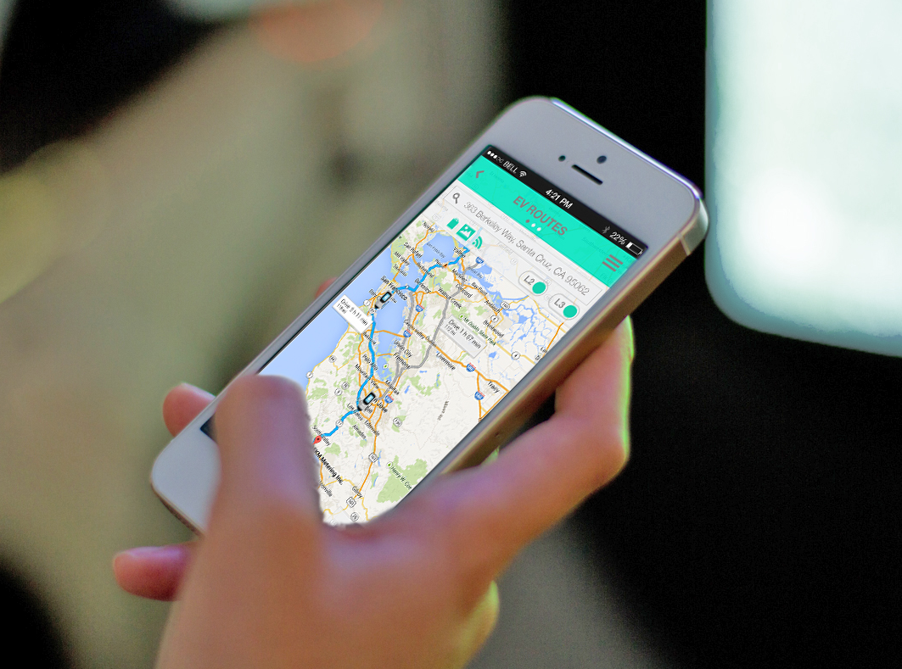

SOLVING RANGE ANXIETY THROUGH AN INTELLIGENT MOBILE APP INTERFACE.
“The best thing for EV’s since the j1772”
– Pac Mech Tech

Slide 2

SOLVING RANGE ANXIETY THROUGH AN INTELLIGENT MOBILE INTERFACE
PROBLEM
Before leaving for a trip, you research the area for working chargers
Currently no way to automatically get route options based on station location and vehicle state of charge.

Slide 3
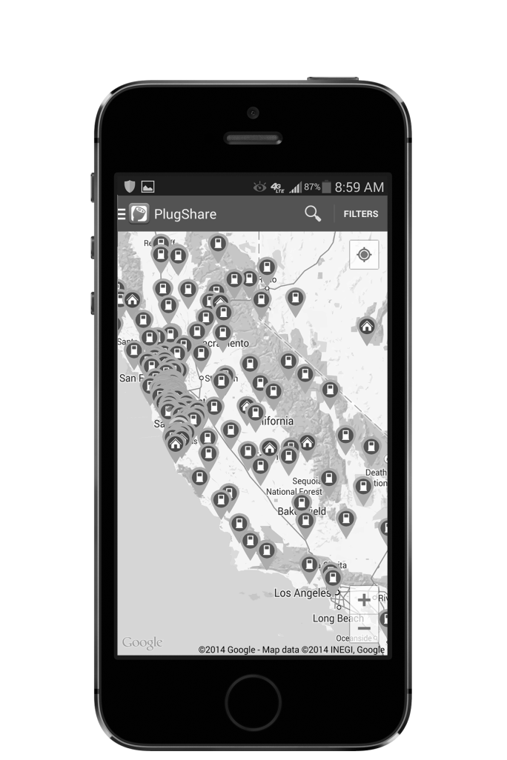
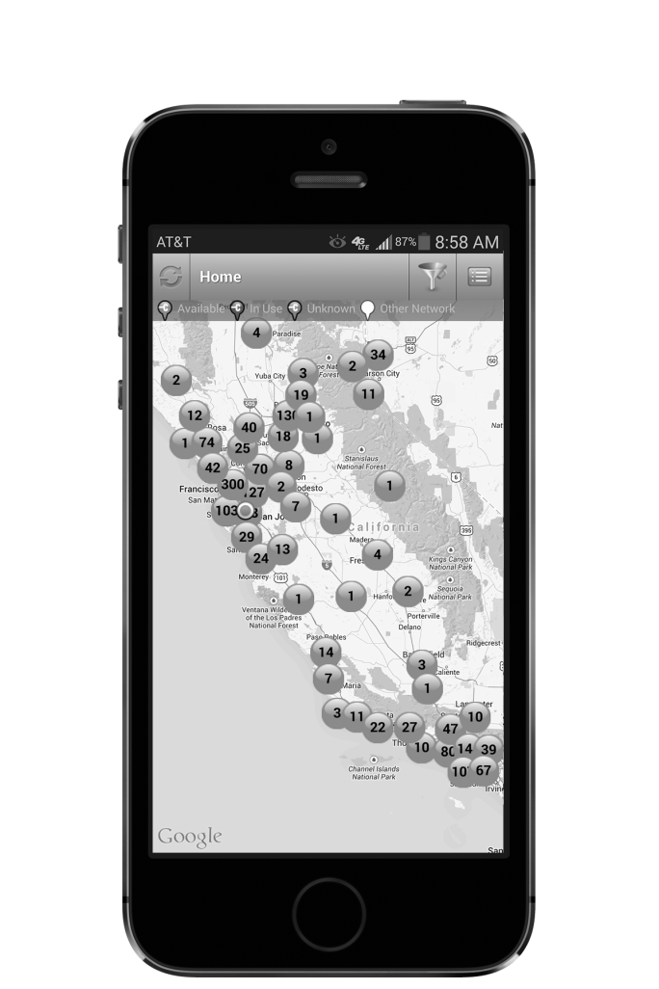
SOLVING RANGE ANXIETY THROUGH AN INTELLIGENT MOBILE INTERFACE
EXISTING SOFTWARE
Manually decipher best route
Does not take vehicle information into consideration
Does not account for environmental conditions

Slide 4
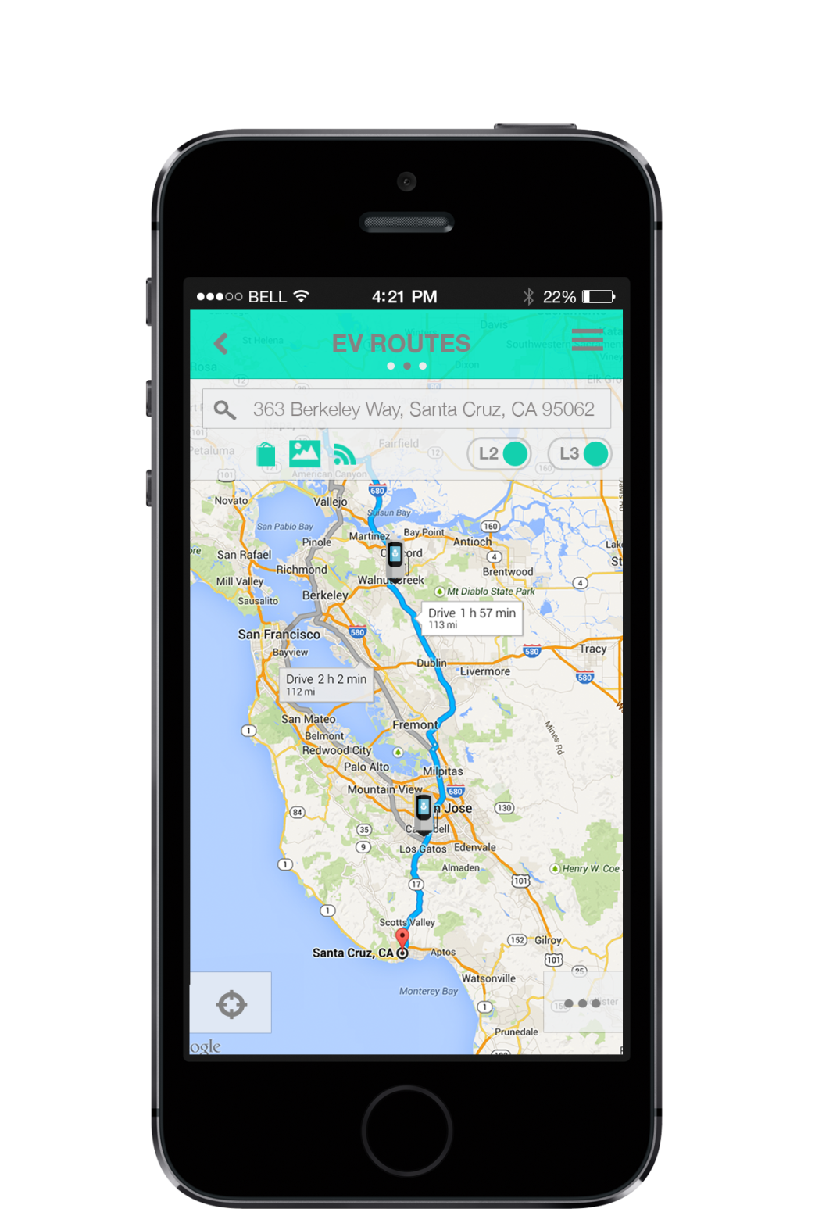
SOLVING RANGE ANXIETY THROUGH AN INTELLIGENT MOBILE INTERFACE
Let EVenture suggest alternative routes putting you near a charger when YOU need it!
EVenture utilizes your vehicle information, and real time data to suggest the best route, NEVER to leave you stranded!

Slide 5

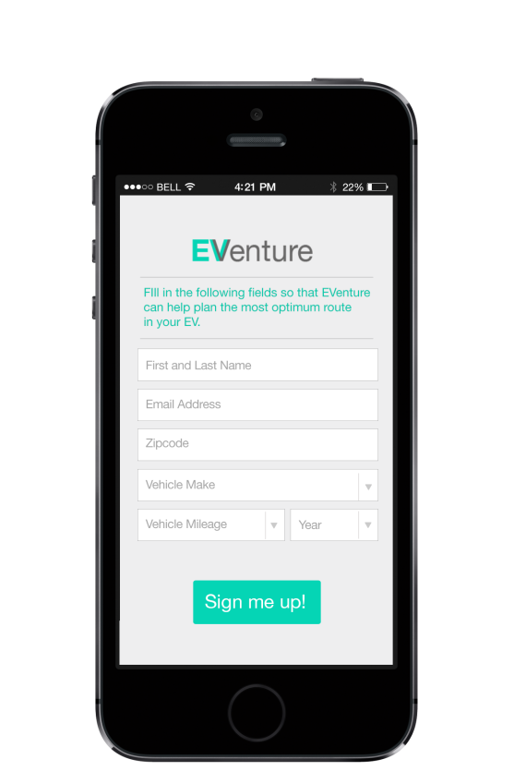
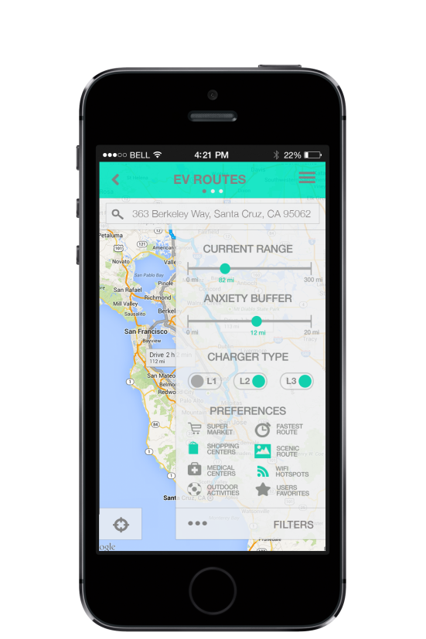
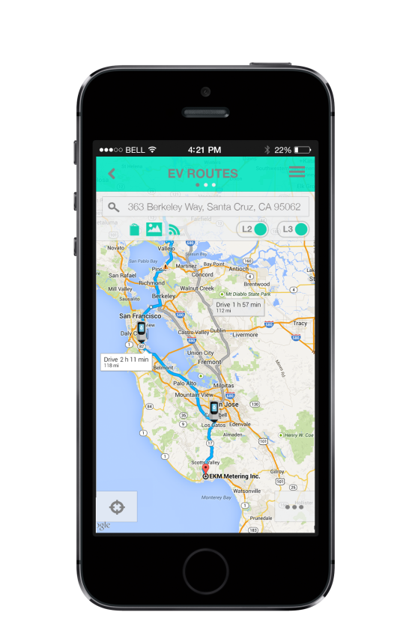
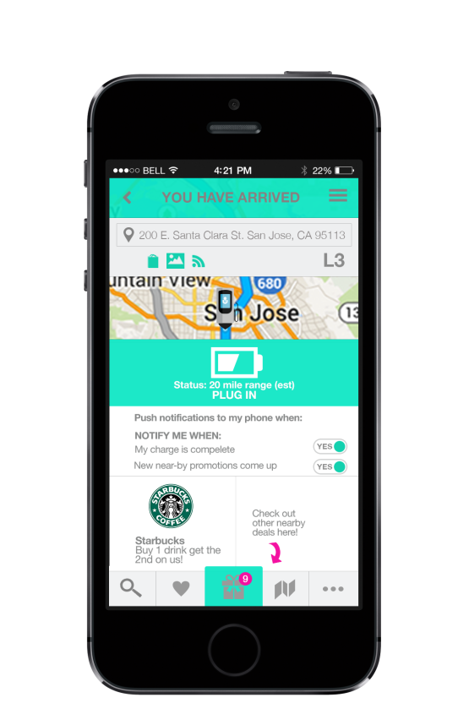
SOLVING RANGE ANXIETY THROUGH AN INTELLIGENT MOBILE INTERFACE
HOW TO USE:
A. Create an account
B. Enter vehicle information
C. Search routes for your next EVenture!

Slide 6

SOLVING RANGE ANXIETY THROUGH AN INTELLIGENT MOBILE INTERFACE
FEATURES
Uses information off your dash display to increase accuracy of the route
Uses location data to leverage current weather conditions increasing route accuracy
Slider to alter ‘Anxiety Buffer’ moving estimated charge destinations

Slide 7

SOLVING RANGE ANXIETY THROUGH AN INTELLIGENT MOBILE INTERFACE
REVENUE
Uses your location data to push targeted advertisements
Utilizes ads to generate revenue making the services FREE to the users
Revenue based on total impressions and clicks of ads
National sponsors support the app with annual service fee

Slide 8
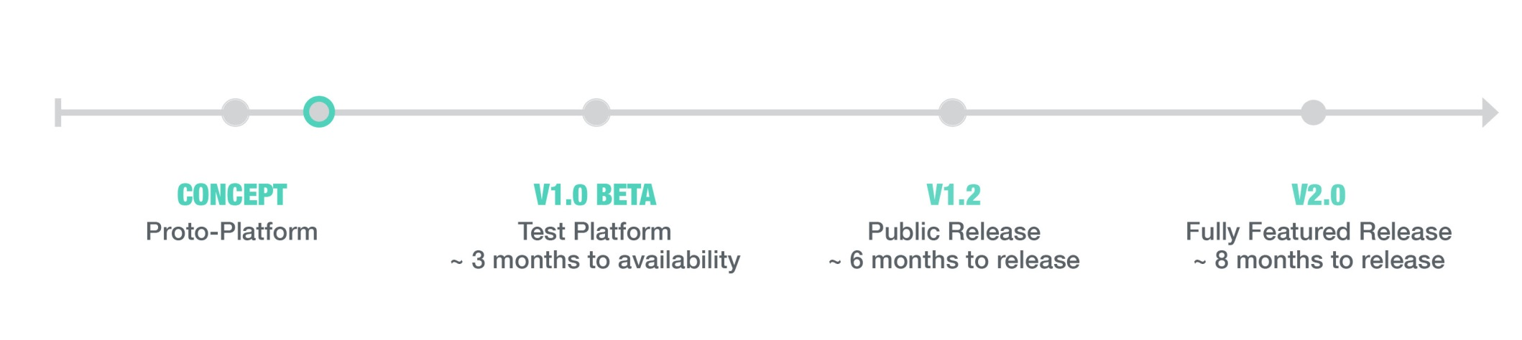


SOLVING RANGE ANXIETY THROUGH AN INTELLIGENT MOBILE INTERFACE
TIME TO MARKET
AVAILABLE IN:

Slide 9
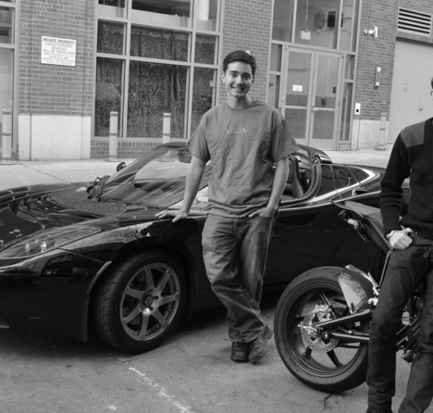

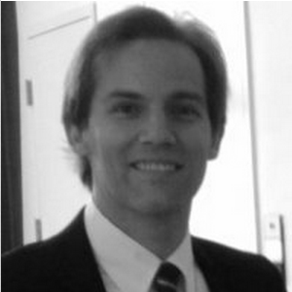
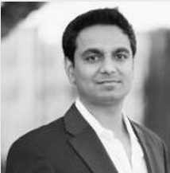
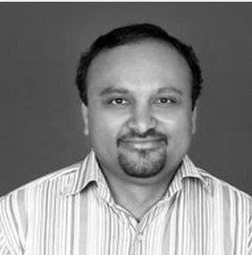

SOLVING RANGE ANXIETY THROUGH AN INTELLIGENT MOBILE INTERFACE
TEAM
Michael Menendez idea / frontend
Charles d’Harcourt backend developer
Mohinish Shaikh frontend developer
Geoff Ryder backend developer
Baswaraju Vuppala backend developer
Katarzyna Babula frontend / graphic design

Slide 10










SOLVING RANGE ANXIETY THROUGH AN INTELLIGENT MOBILE INTERFACE
POTENTIAL
NATIONAL SPONSORS

Slide 11
SOLVING RANGE ANXIETY THROUGH AN INTELLIGENT MOBILE INTERFACE
CONTACT
eventuremobileapp@gmail.com
760.383.1225

Slide 12

SOLVING RANGE ANXIETY THROUGH AN INTELLIGENT MOBILE INTERFACE
DEMO
eventuremobileapp@gmail.com

